Slide 1
HOPE ACADEMY

Slide 2
Contents
01 | Features of the website
02 | Tools used
03 | Features of Front End & Backend
04 | Database Connection
05 | Limitations
06 | Future Works

Slide 3





25%
35%
10%
12%
Tools used to Build the Website
HTML
CSS
Java Script
PHP
MySQL
08%
About 25% HTML language is used to build the frontend of the website
35% CSS language is used to beautify the website
Java Script is also used in website
for 10%
Despite being the least used language ,PHP is one of the most needed language.
About 12% of MySQL is used to get the input and output from the database .

Slide 4
Features of the website
01
02
03
04
05
Home page
About Us
Login/Registration
Features of the homepage of hope academy
What is Hope Academy?
Register or login to see the courses
Available Courses
Student/
Tutor Profile
Available courses to get enrolled
Information of enrolled students and registered instructors

Slide 5
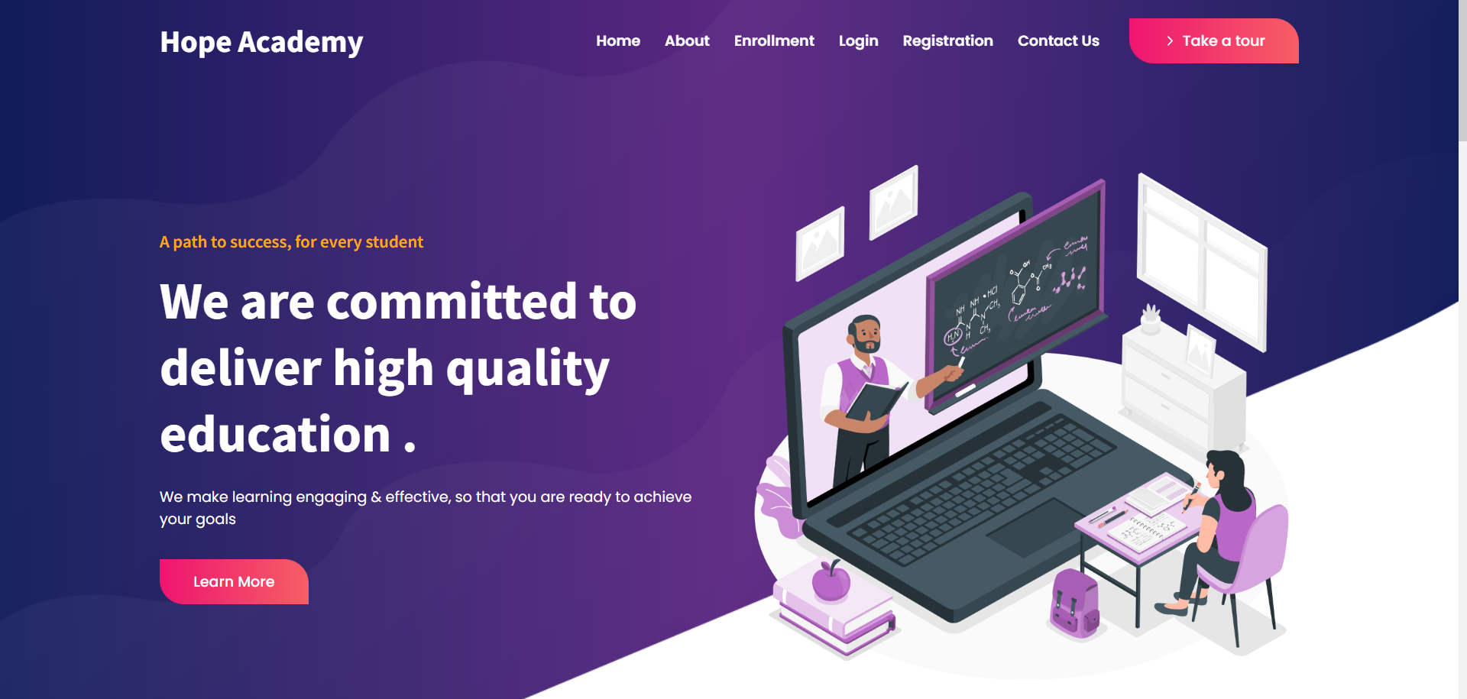
Homepage
01

Slide 6
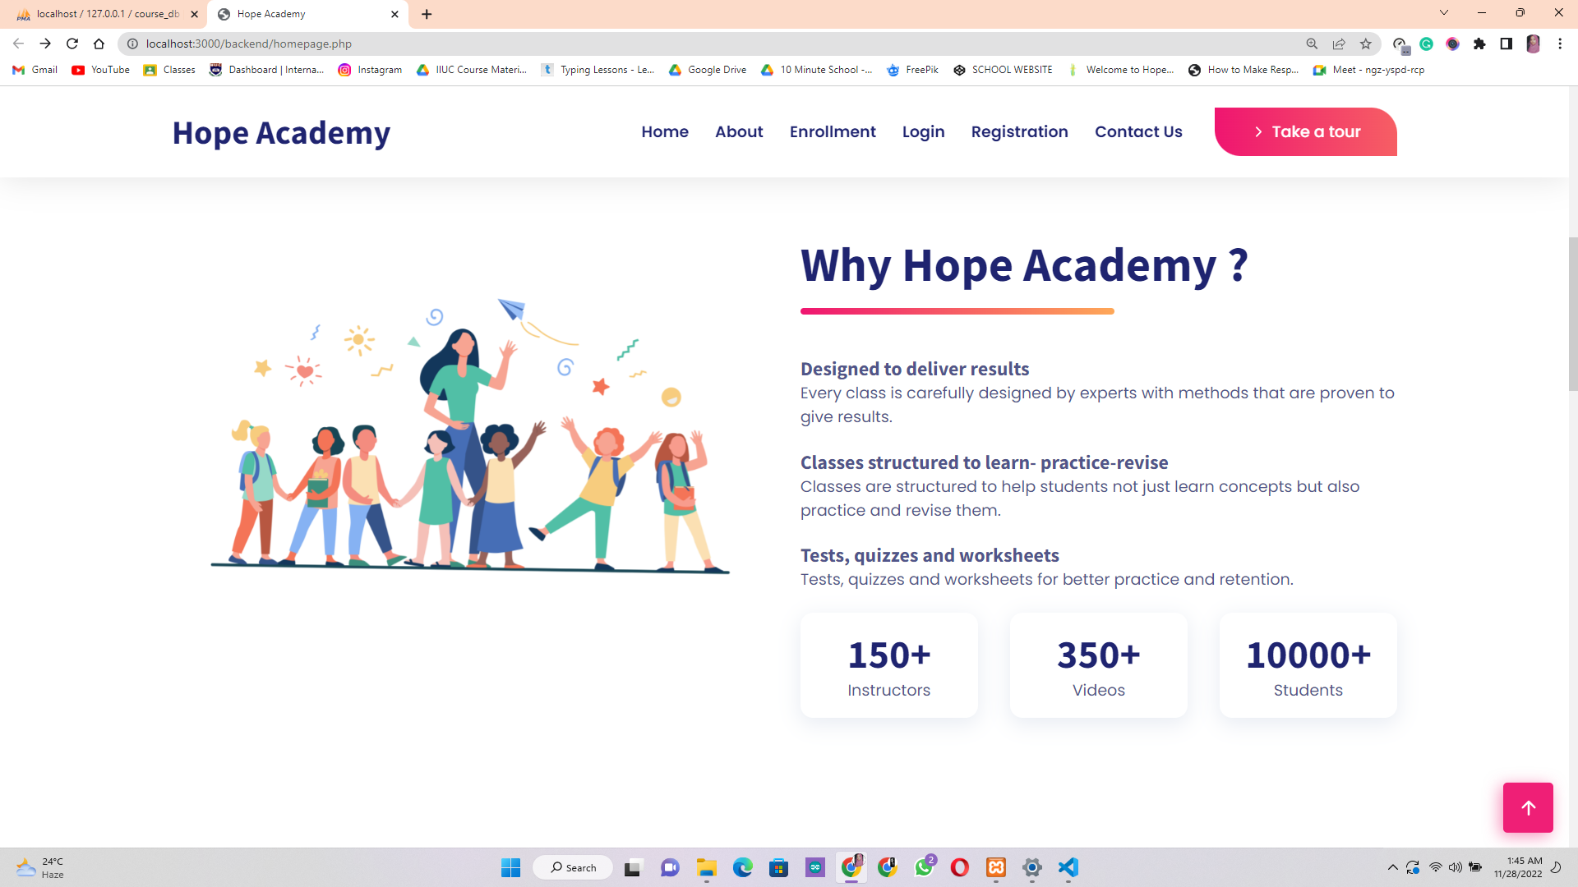
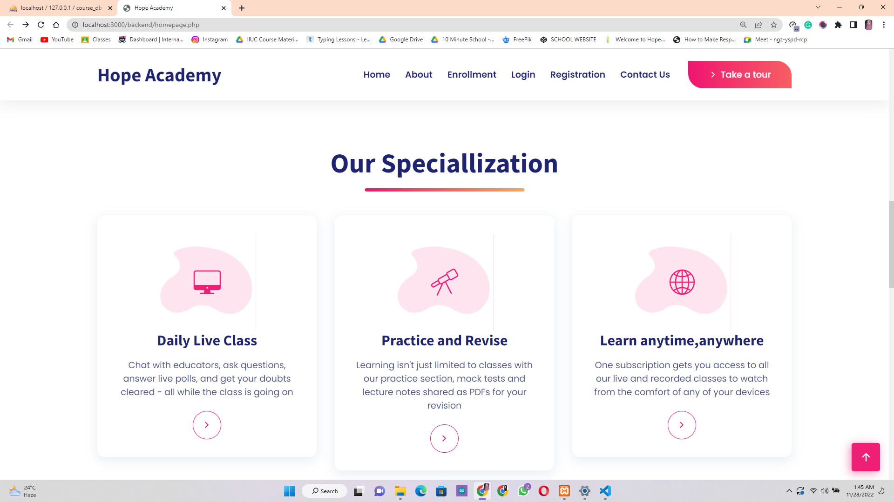
02
Why you should use our website ?
Our website specializes in a student friendly environment where they can find their desired contents easily and learn them effectively .

Slide 7
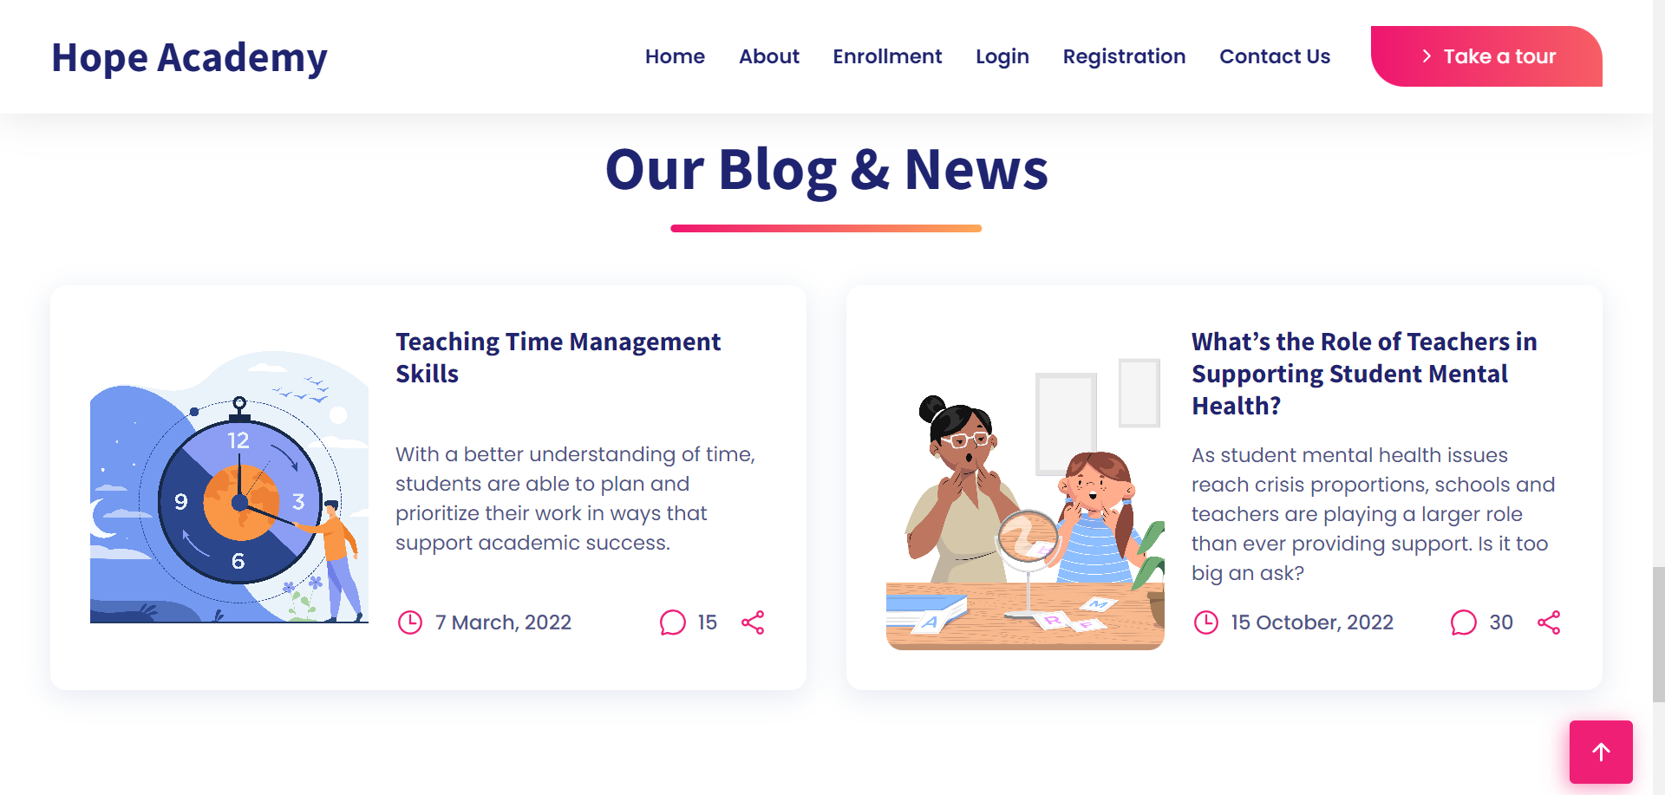
News & Views

Slide 8
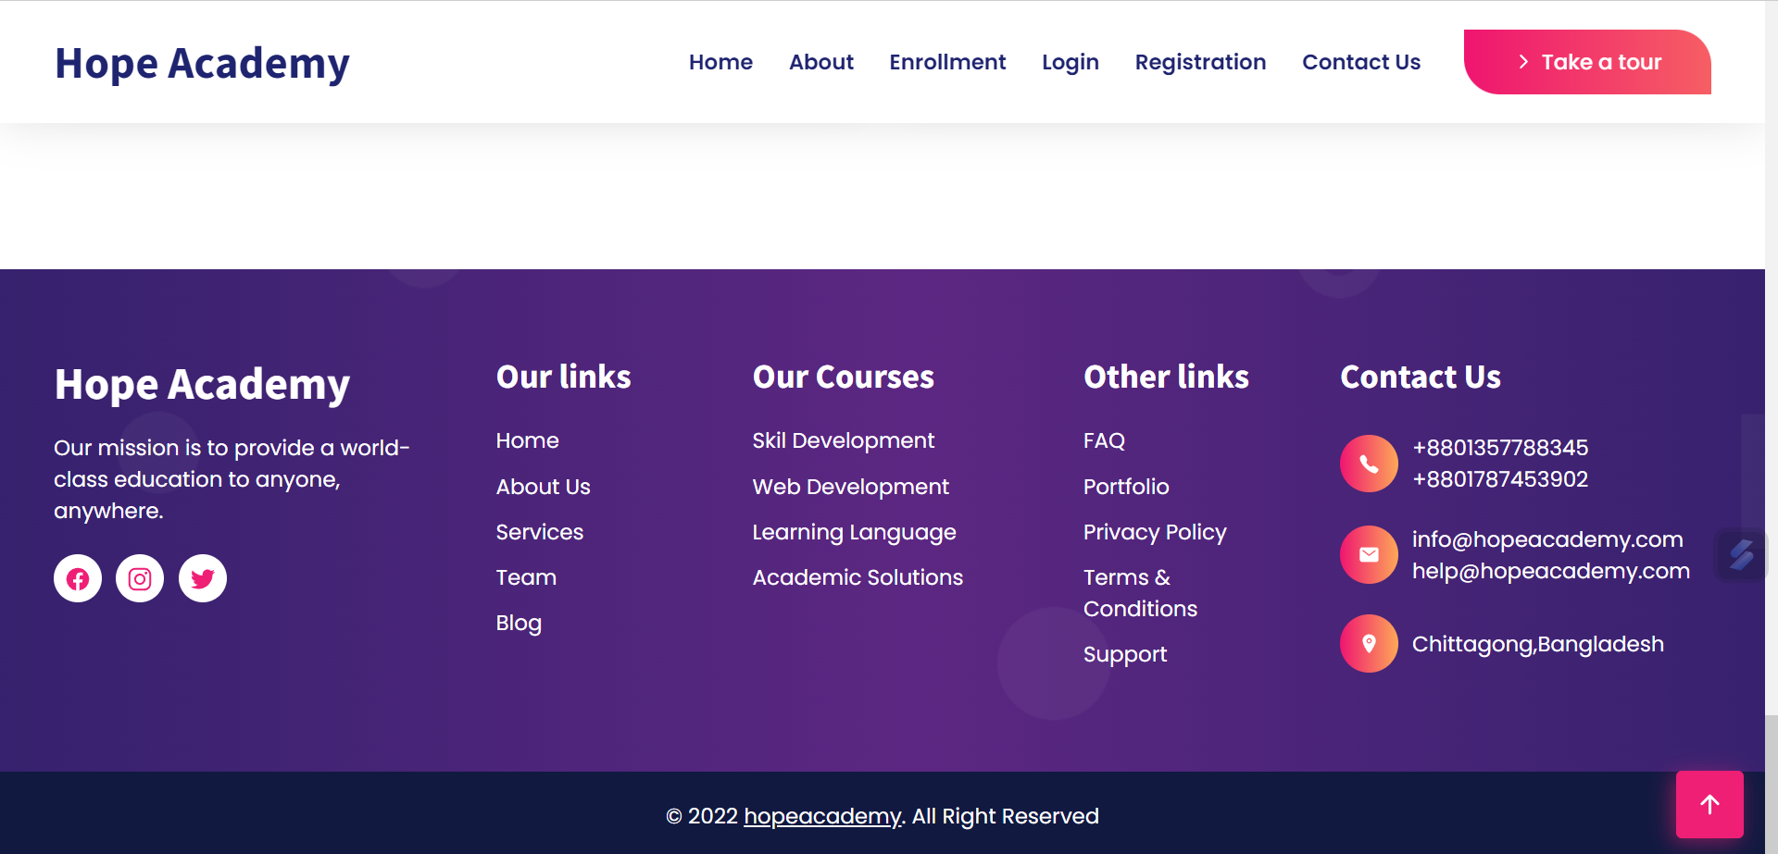
Footer
Our website footer have the social media links of our academy and also the ways to contact us immediately for any queries .

Slide 9
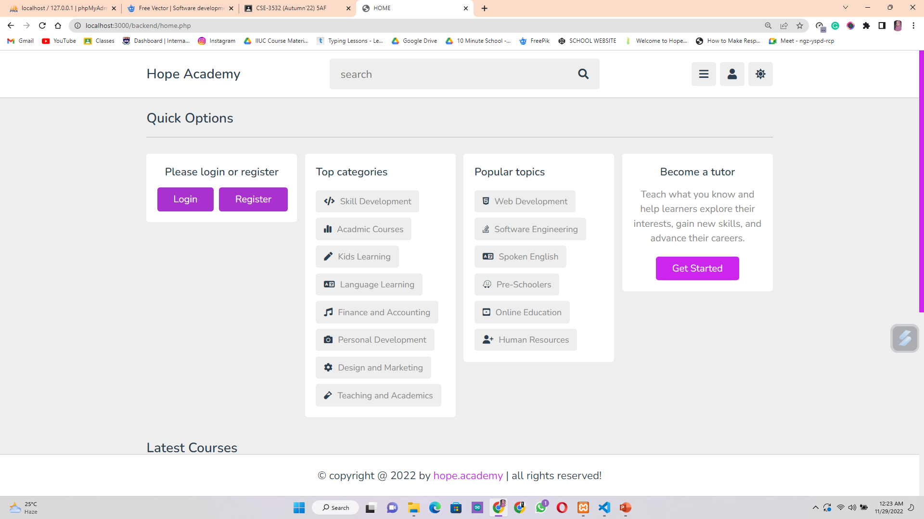
Quick Options
In this section any user can log in or register their accounts , have a quick look to all of our courses they can be enrolled and the popular topics of our website too .

Slide 10
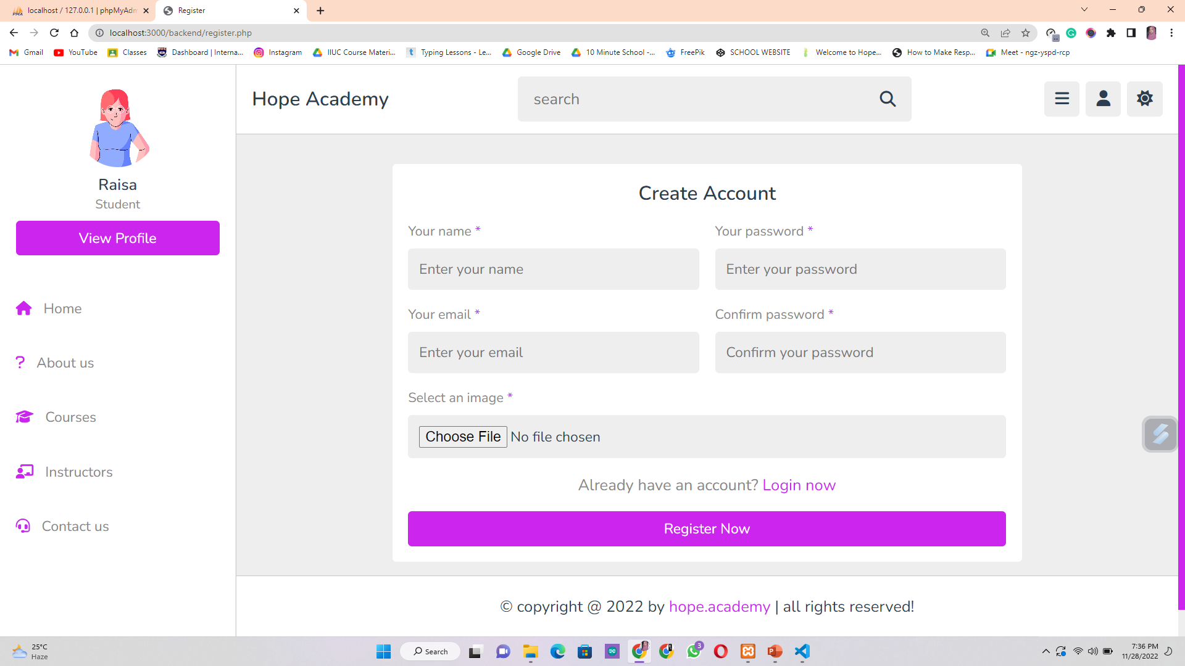
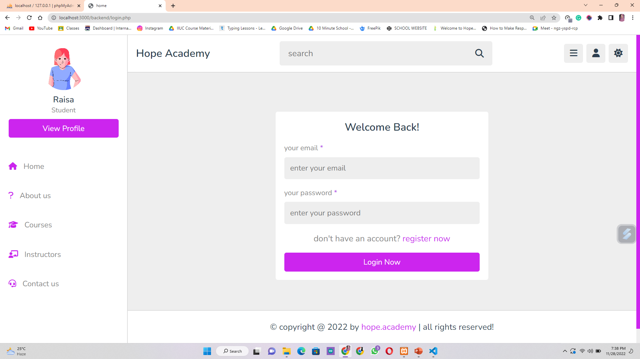
Student Login & Registration Page
03
The Students can register a new account with a username, email and password and if they have previous account they can log in by entering email and passwords . We also have a feature of adding profile picture to the account .

Slide 11
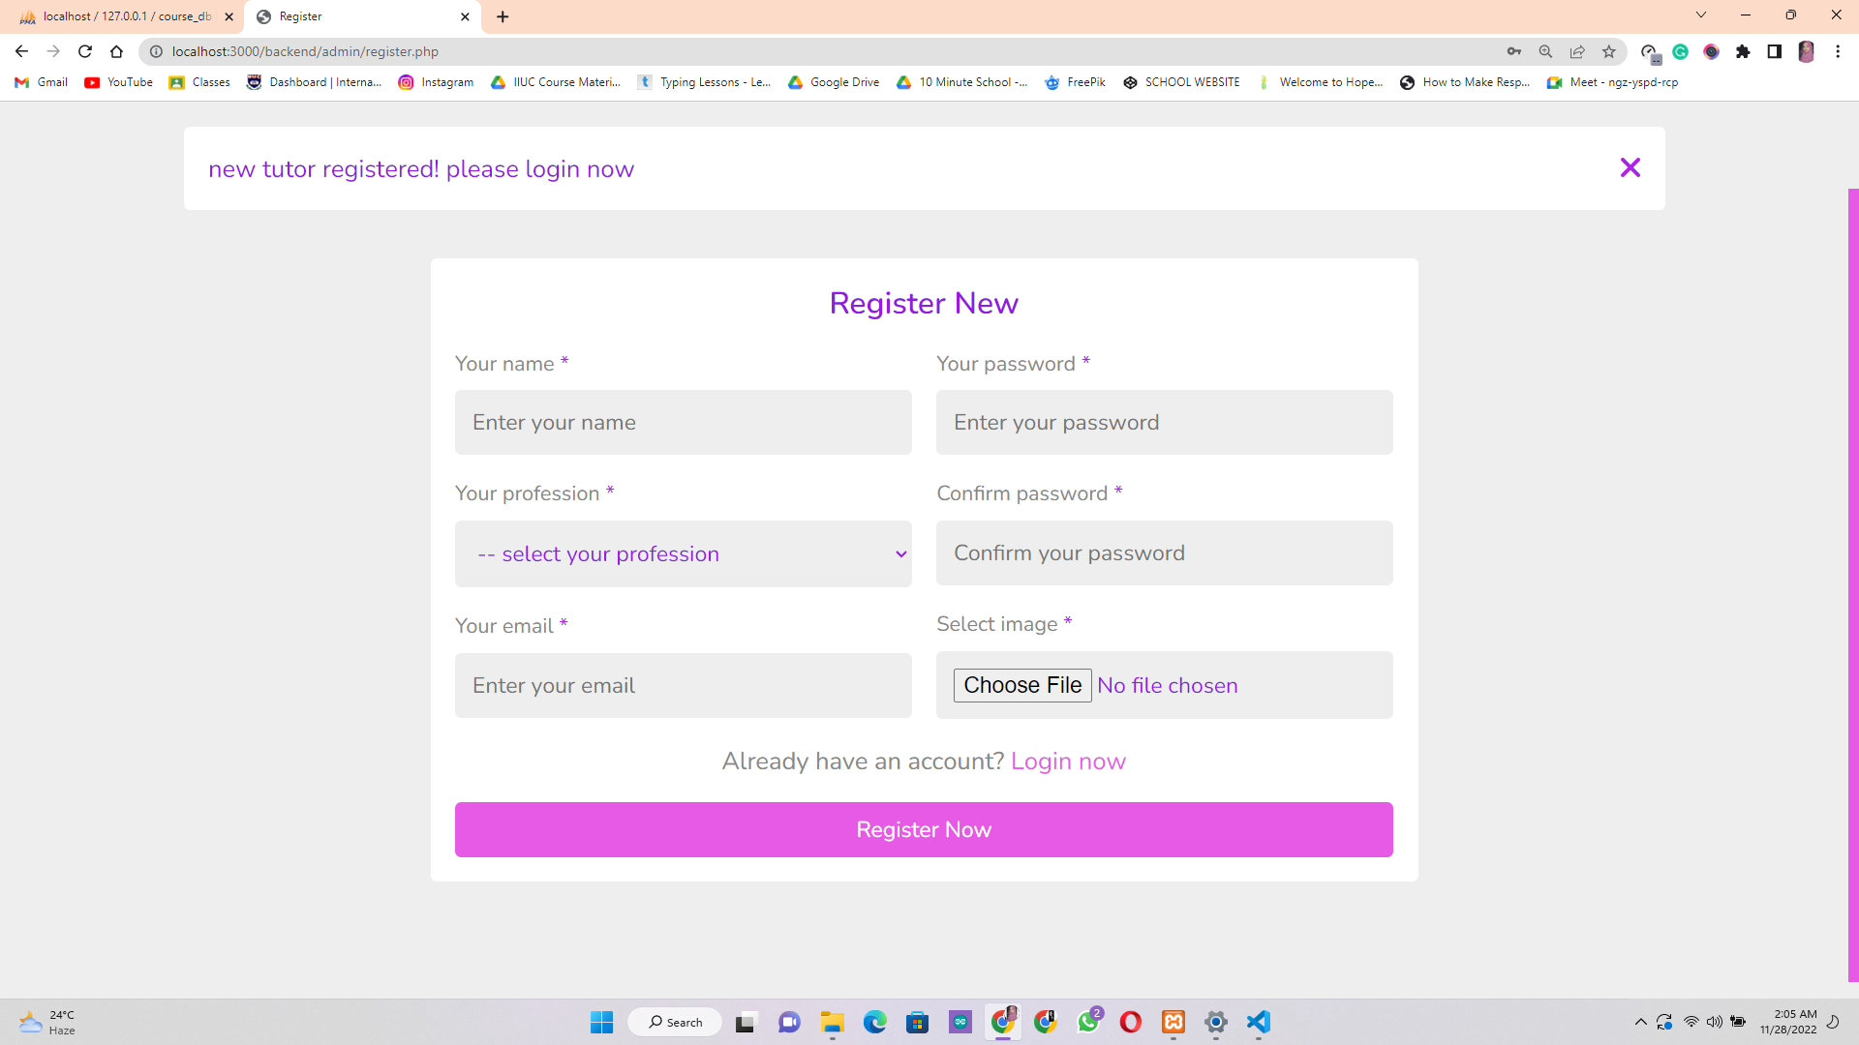
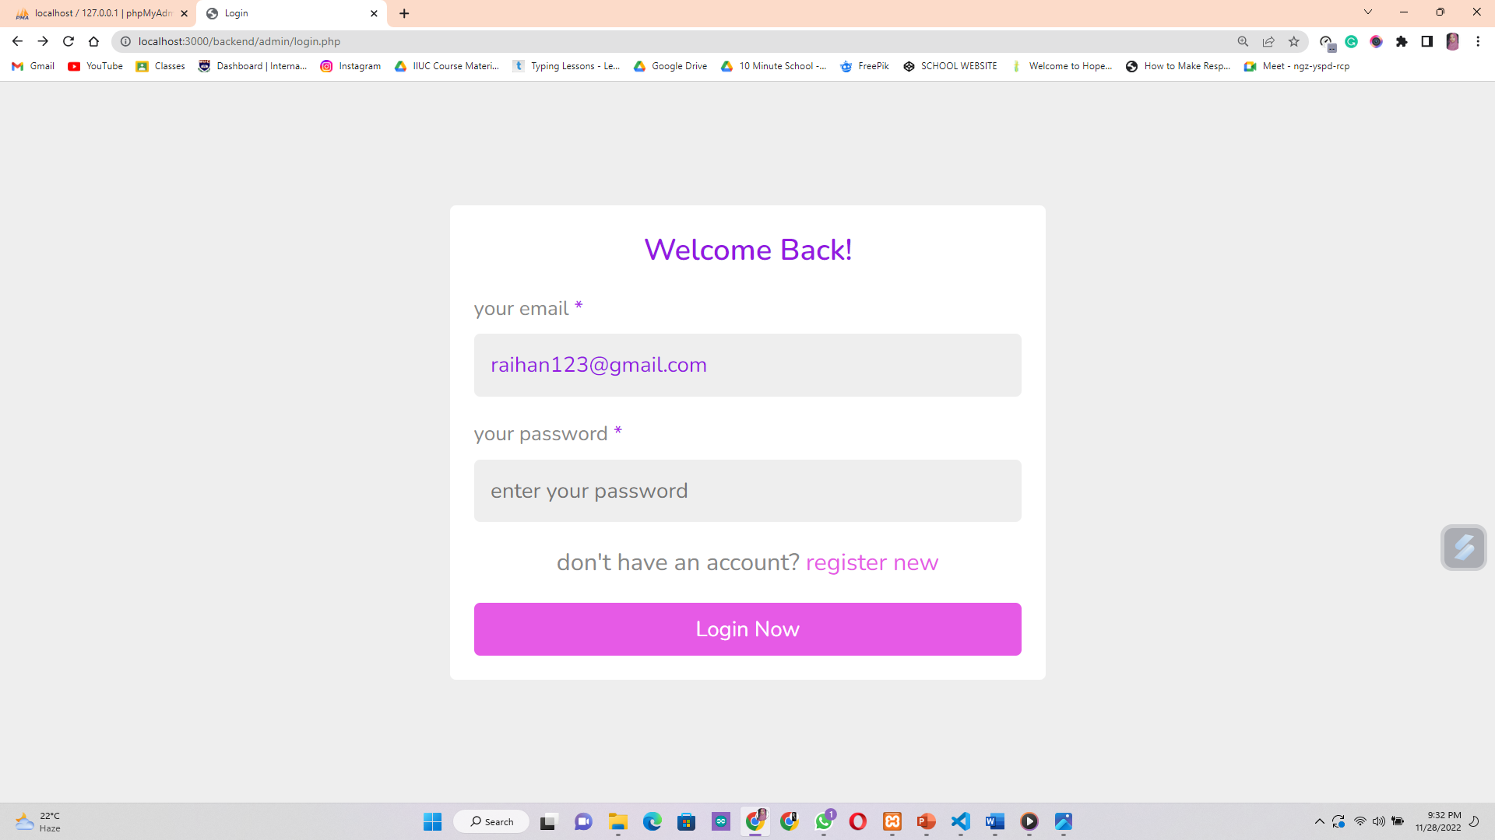
03
Instructor Login & Registration Page
The Instructors can open their new account with the registration form and if they have any account created before they can log in to their previous account by entering email and passwords .

Slide 12
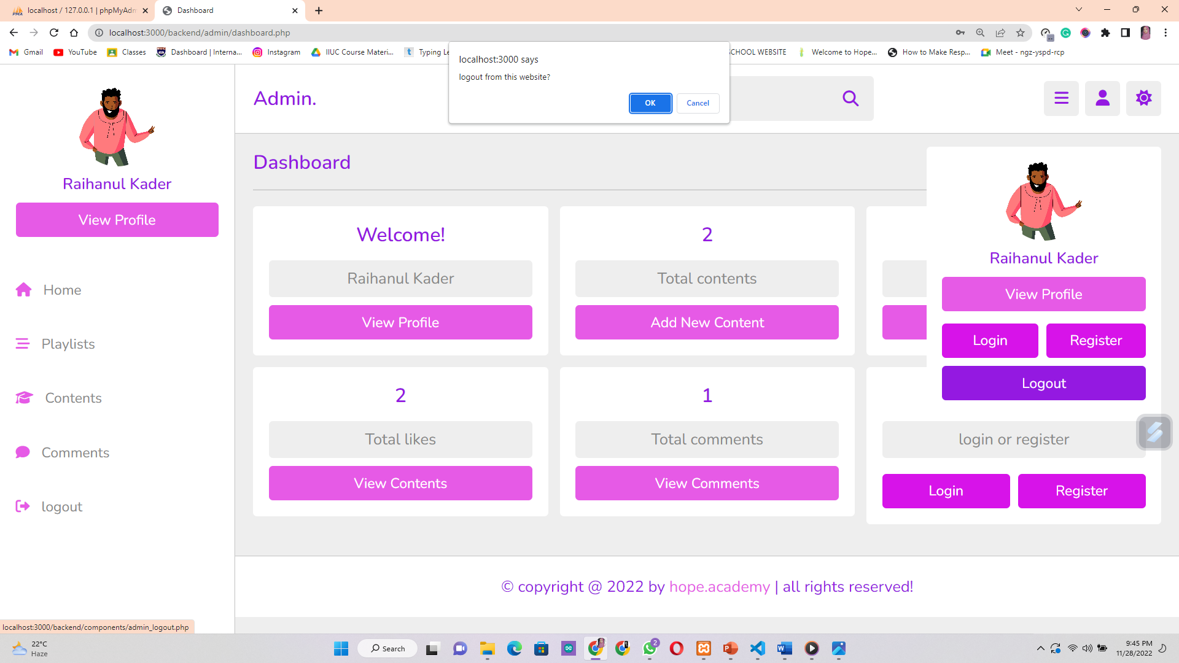
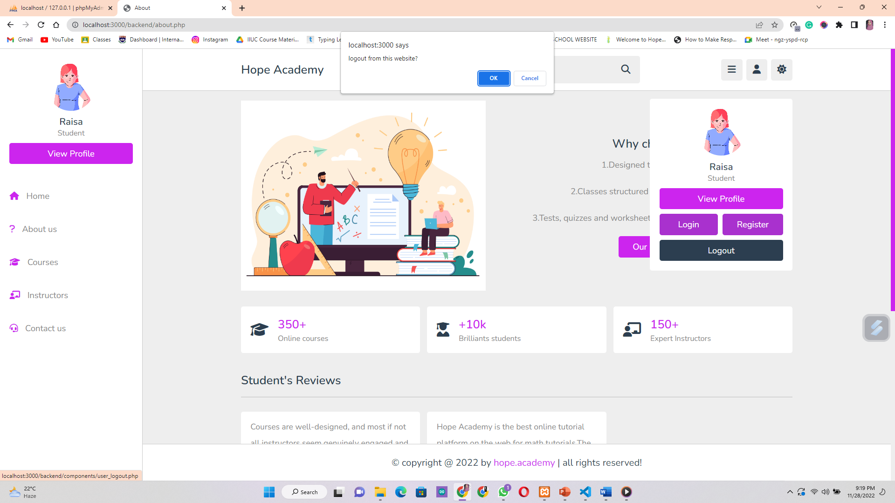
Instructor & Student Logout Page
the instructors and the students will be logged out upon clicking the log out button and they will be shown a confirmation message whether they want to log out or not .

Slide 13
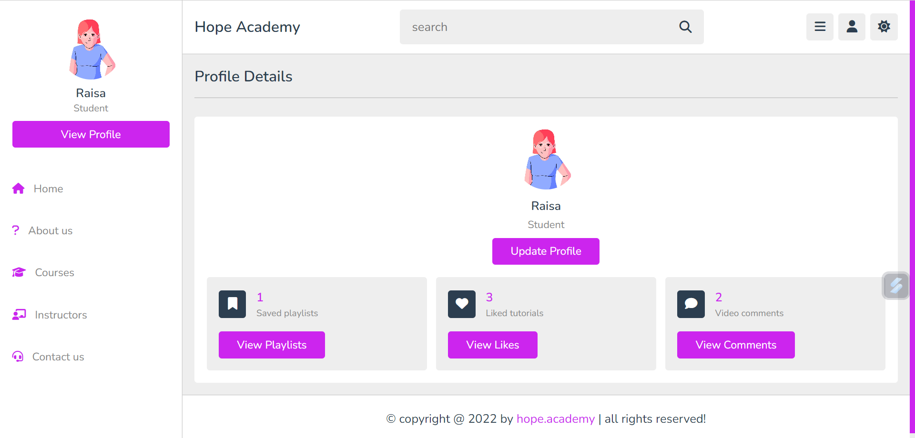
Student’s Profile
04

Slide 14
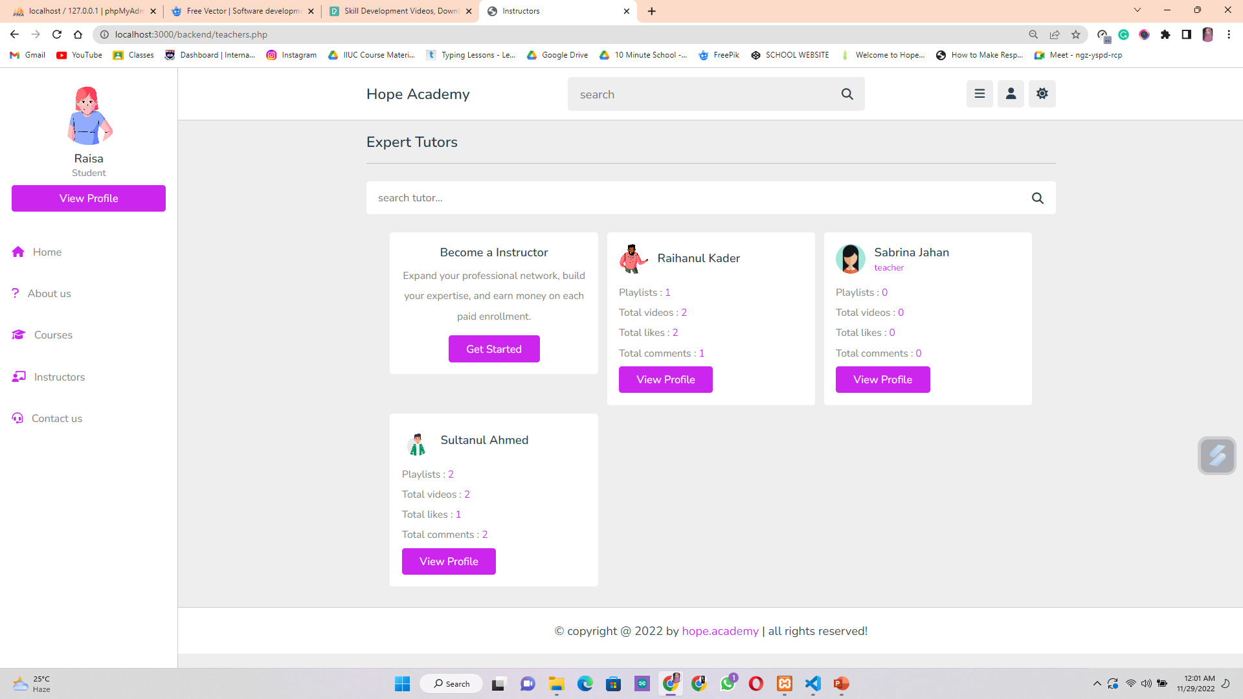
Our Expert Instructors

Slide 15
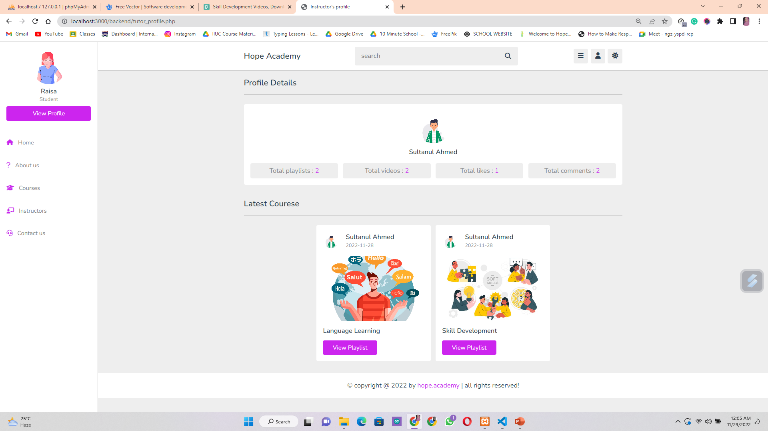
Tutor’s Profile
04

Slide 16
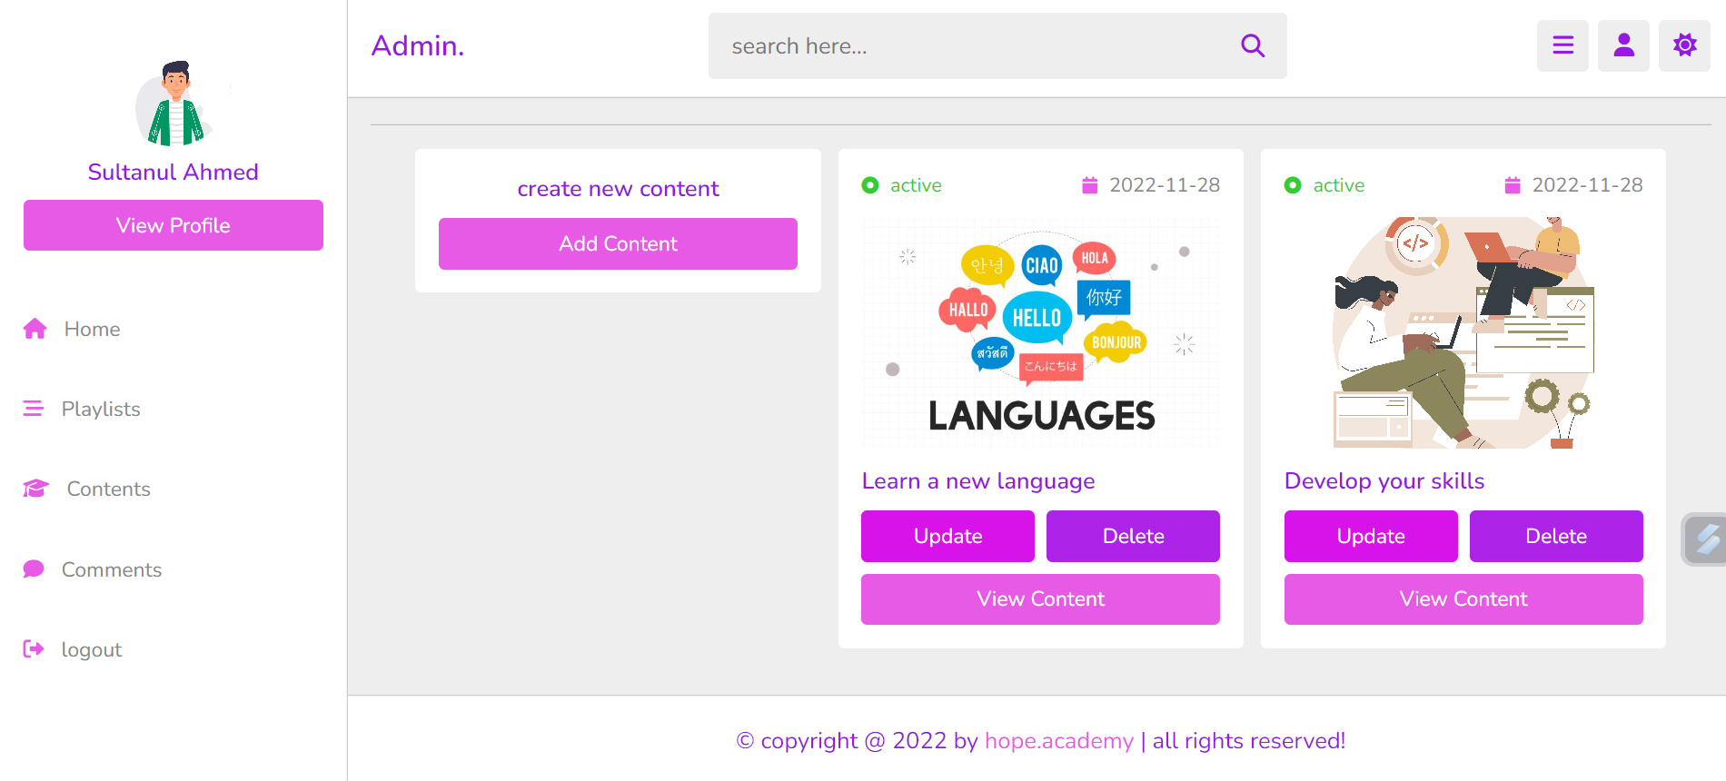
Dashboard of the Tutor

Slide 17
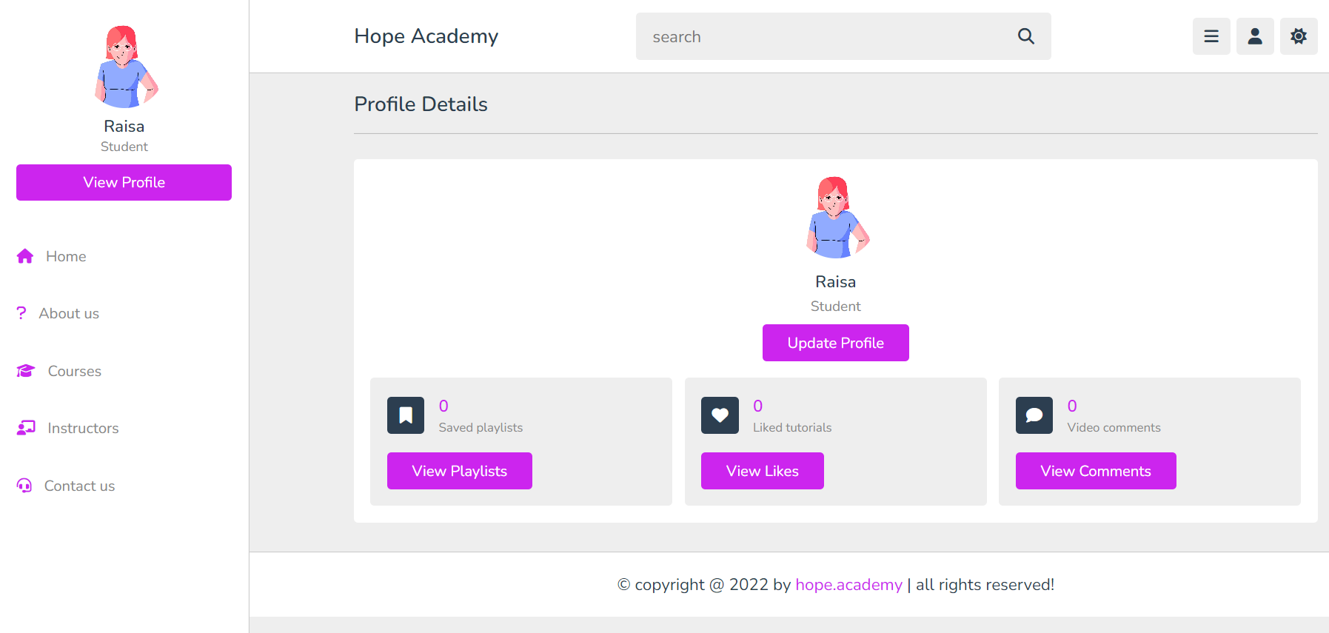
Dashboard of the Students

Slide 18
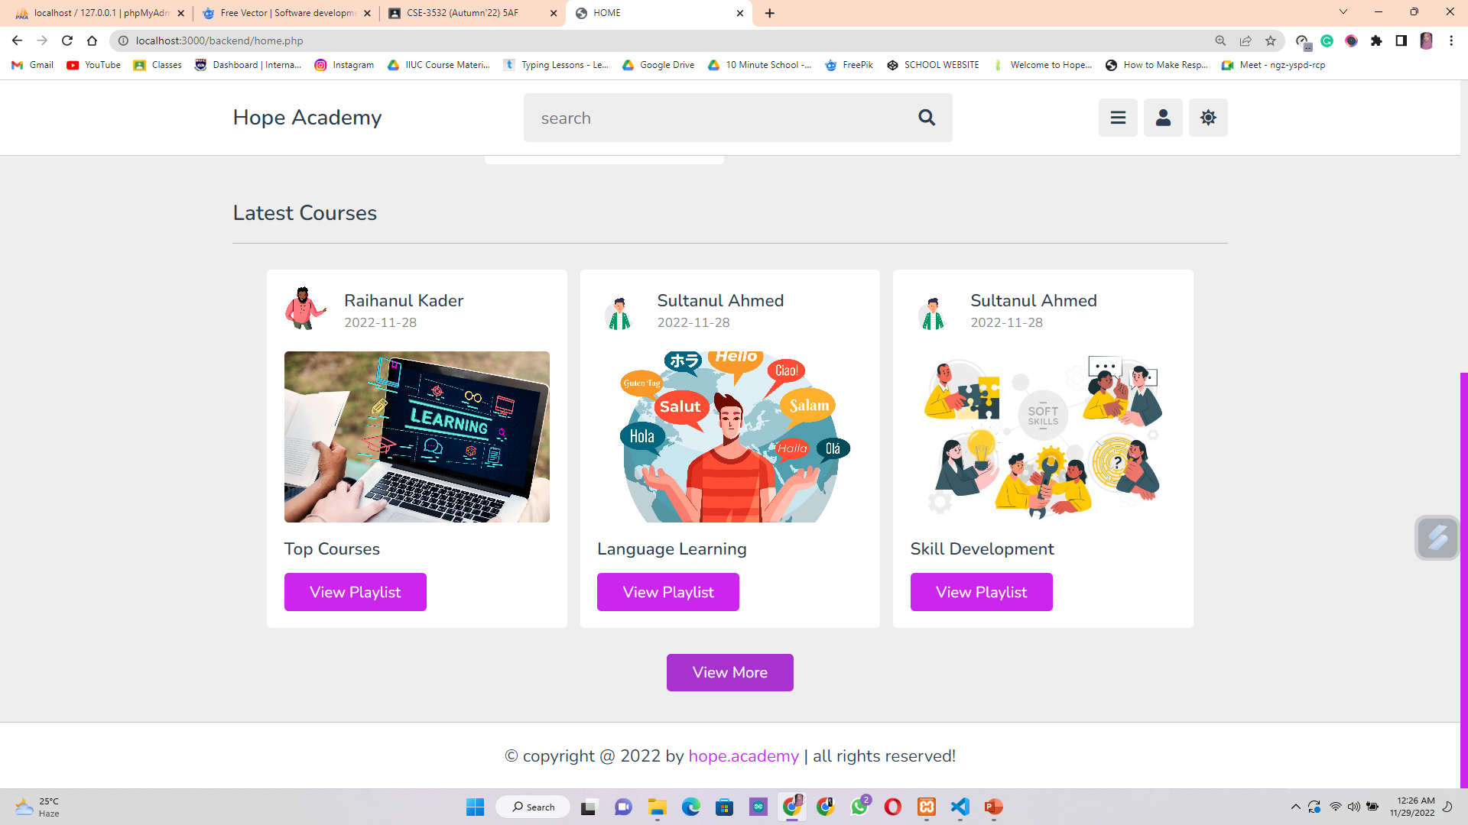
Available Latest Courses
05
In the course section , students can easily find our latest courses to enroll .

Slide 19
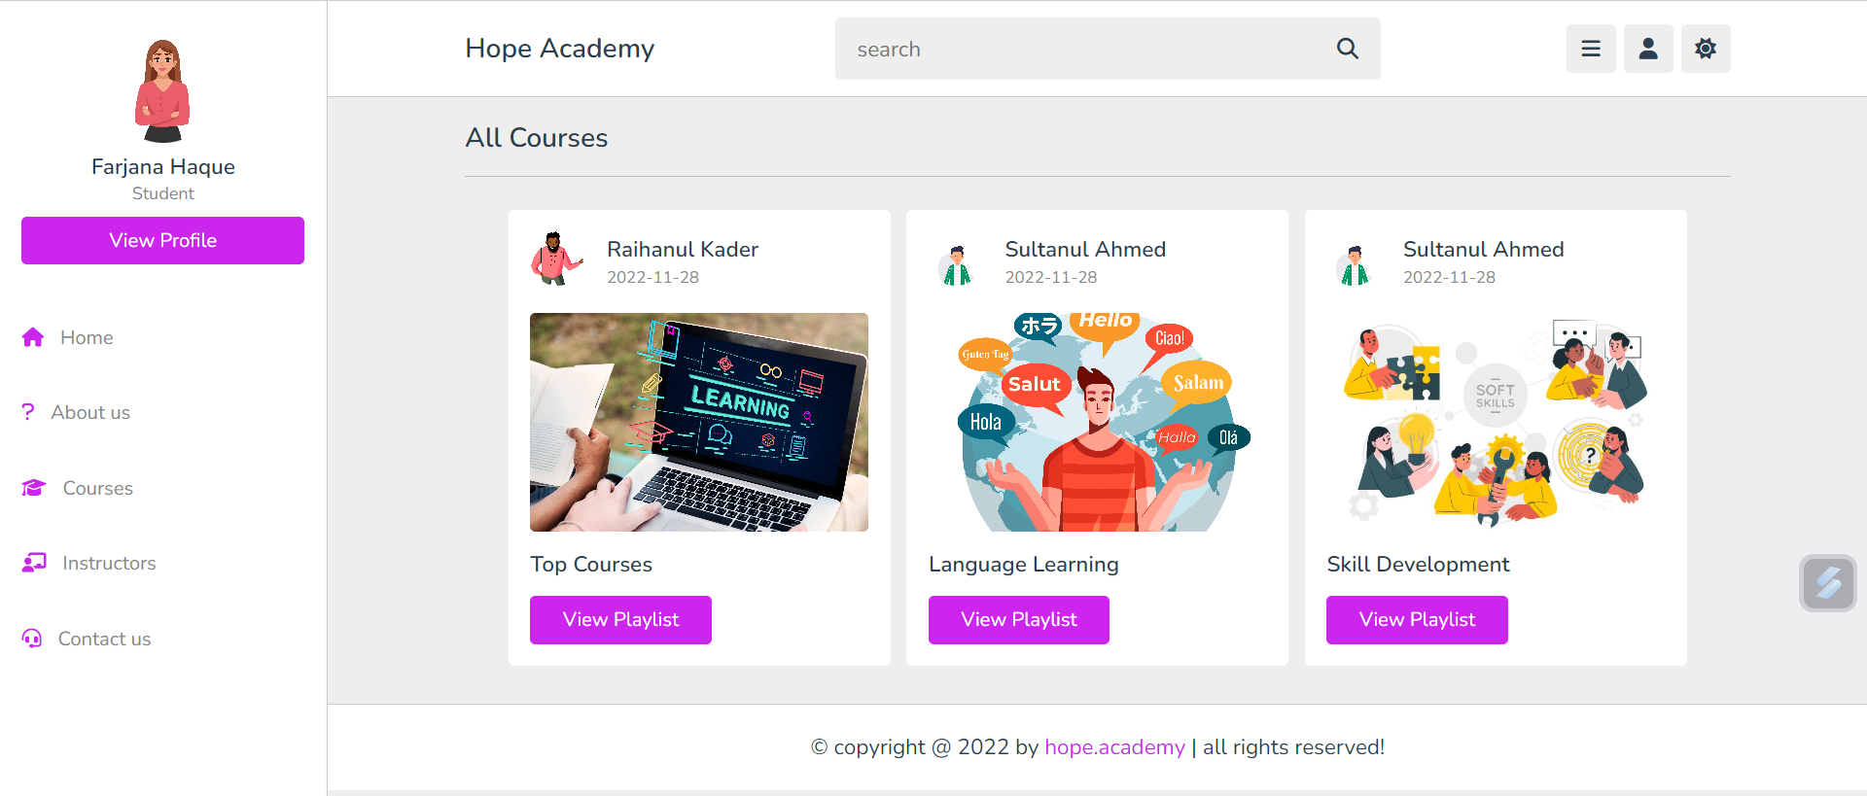
Added Playlists by the Tutors
Tutors can create playlists to add their lecture videos and students can easily find them from the playlists.

Slide 20
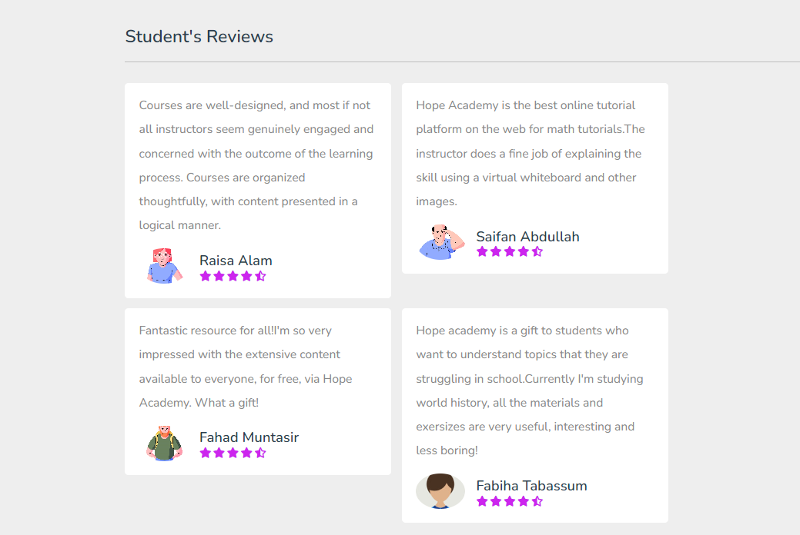
Course Reviews by the Students
Students can give reviews about the courses they have enrolled or the tutors they have liked .

Slide 21
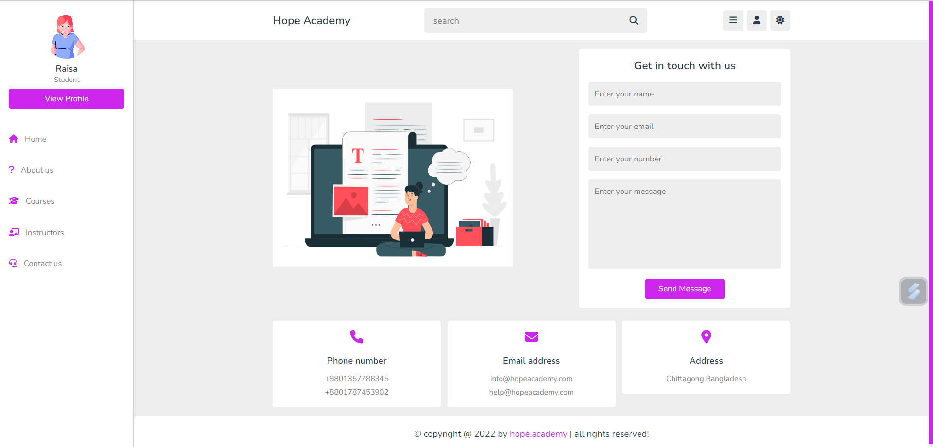
How you can contact us ?
The users can contact with the academy by the hotline number , by sending us a message or via email .

Slide 22
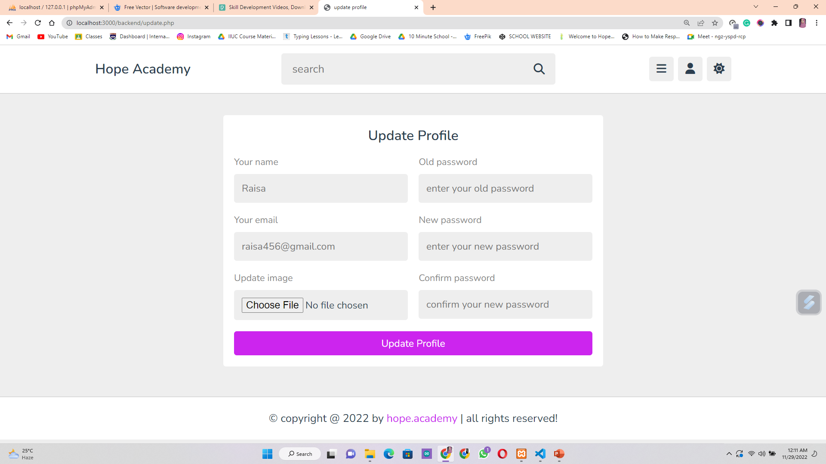
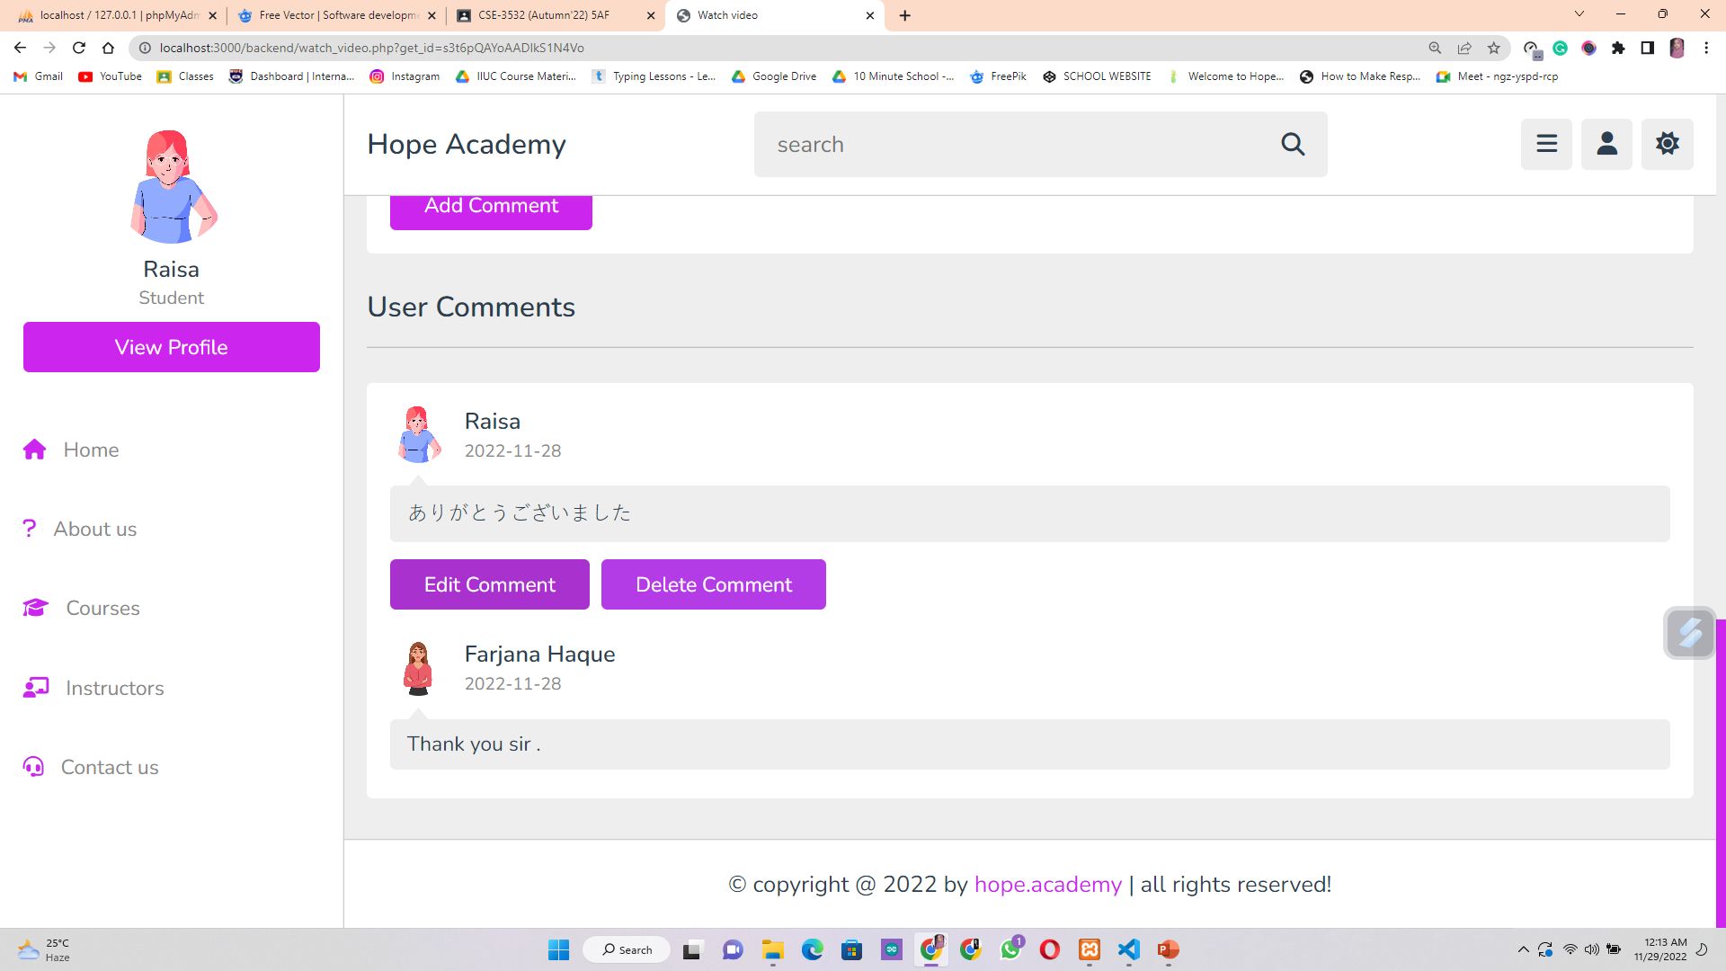
CRUD API’s Used in this Website
We have used CRUD API’s to update , edit and delete the profiles or the comments of the users .

Slide 23
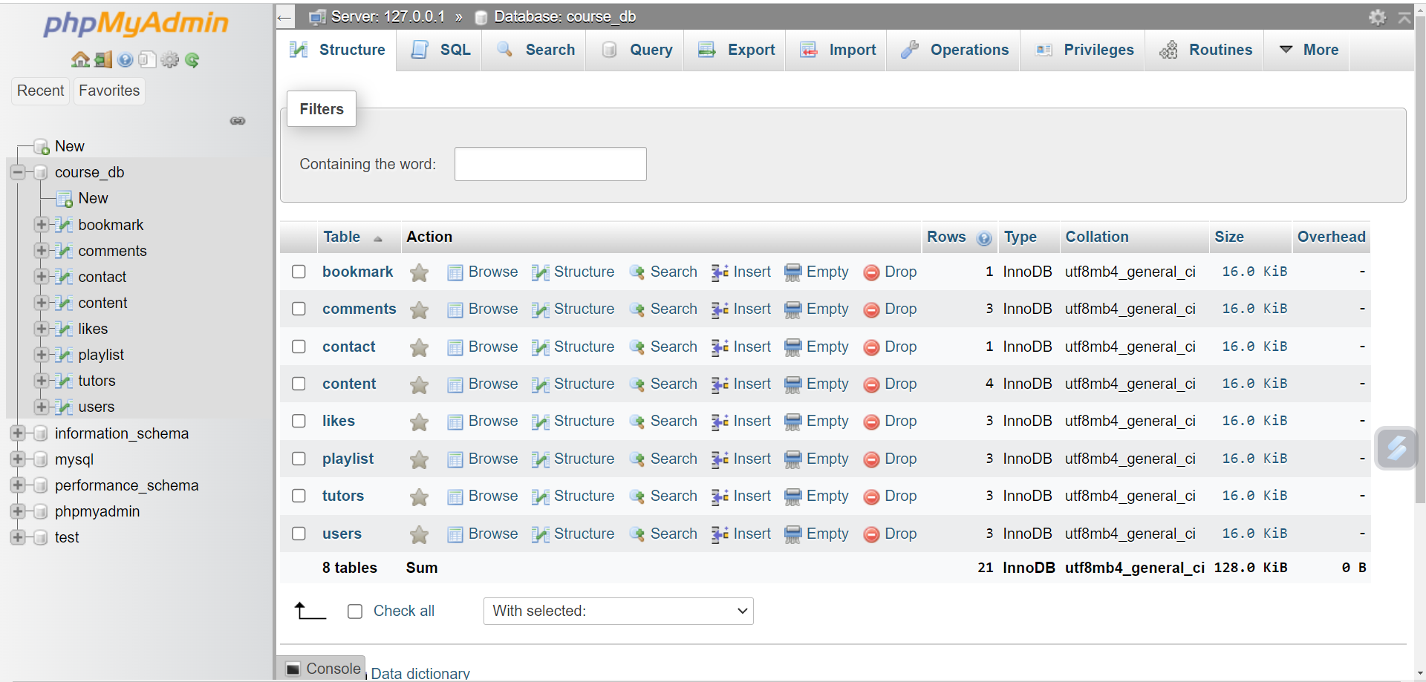
Database for the Website
This is the main database of our website where we have added all the tables to store the information of tutors and students .

Slide 24
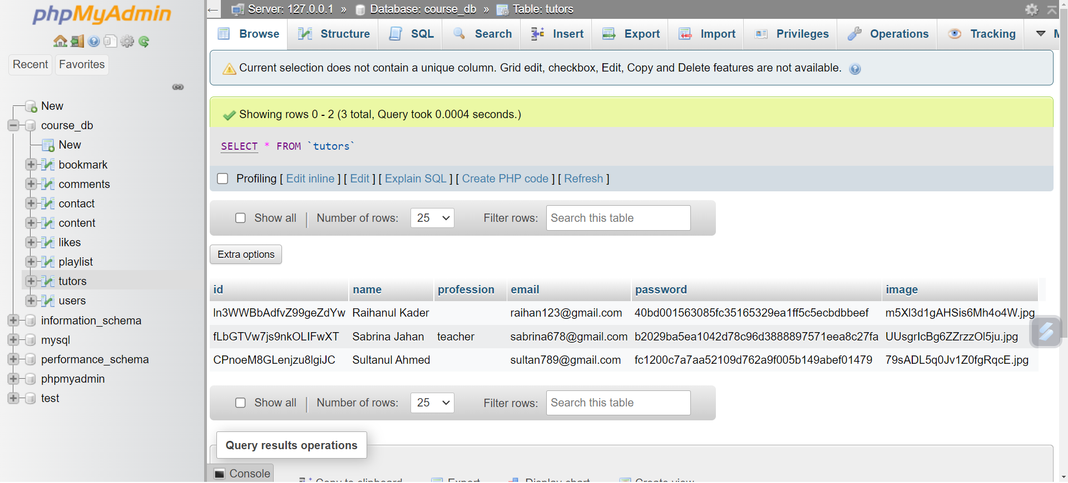
Tutors Database
When the tutors get registered or login with there email all their information are stored here in the tutors database .

Slide 25
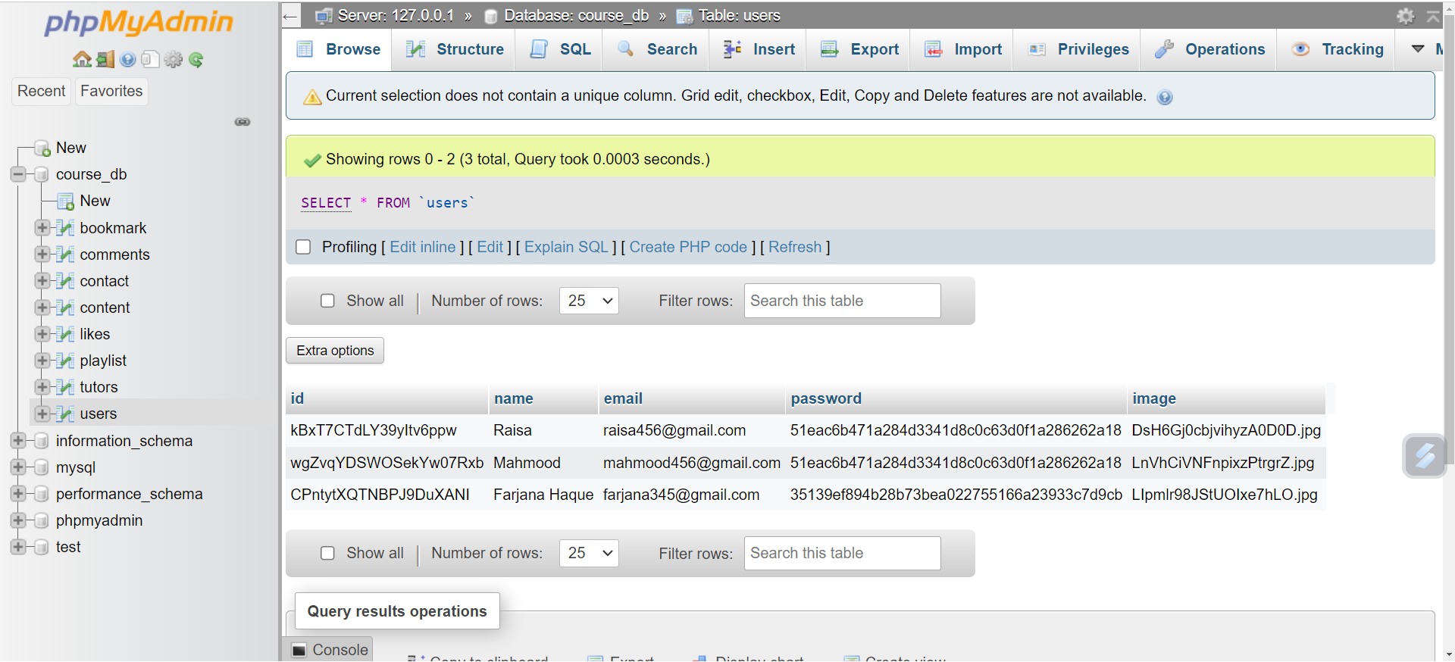
Student Database
The student database stores all the information added by the students upon registration or login .

Slide 26
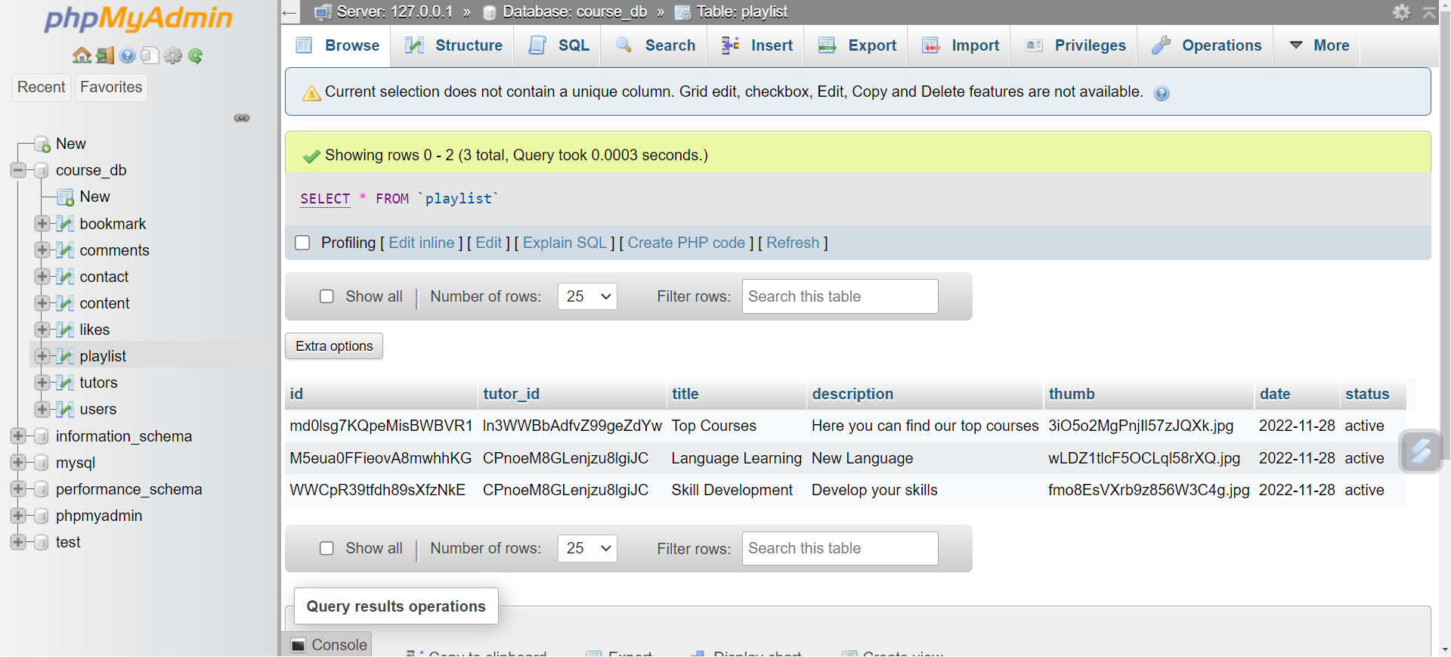
Database of Playlists
This is the database of the playlist created by the tutors .

Slide 27
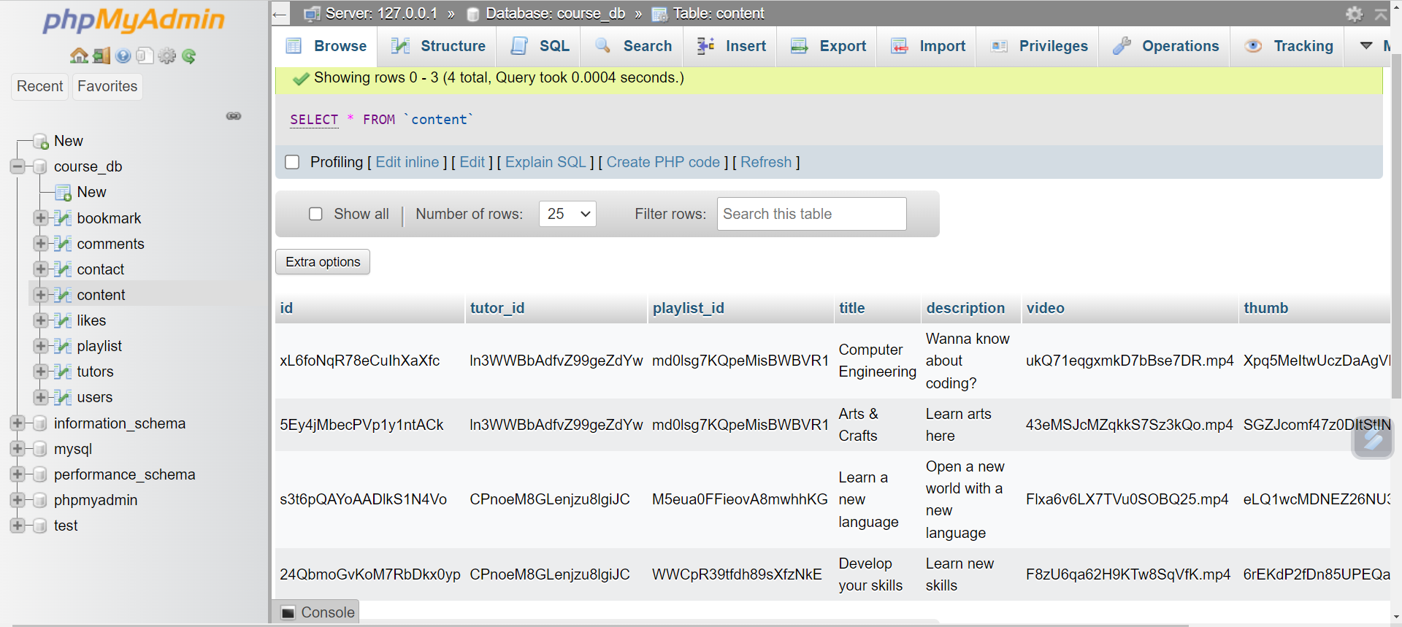
Database of the Contents
All the contents will be added in the database when created by the tutors .

Slide 28
Limitations of the website
Communication gap between the tutors and students
Prolonging loading time.
Limited e-commerce functionality

Slide 29
Future Goals to Achieve
Creating and uploading new contents and features like premium user contents, online payment facilities etc . Responding to the queries of the users . Updating features frequently . Adding various social media platforms where users can interact directly with the teachers . Fix the technical issues immediately .

Slide 30
Thank You!

